Slide 1
Containment Chart
The Cold War

Slide 2
The Cold War
The US was opposed to the spread of communism during the Cold War.
Containment was taking measures to prevent any extension of communist rule to another country.

Slide 3
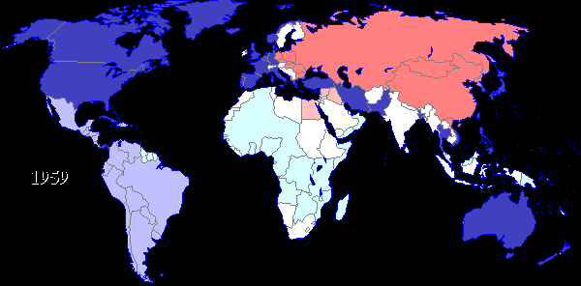
We were afraid…

Slide 4
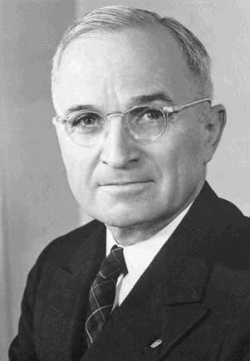
Truman Doctrine
Gave $400 Million in economic & military aid to Greece & Turkey.
1947
To fend off communism and stay free.

Slide 5
Form
Economic

Slide 6
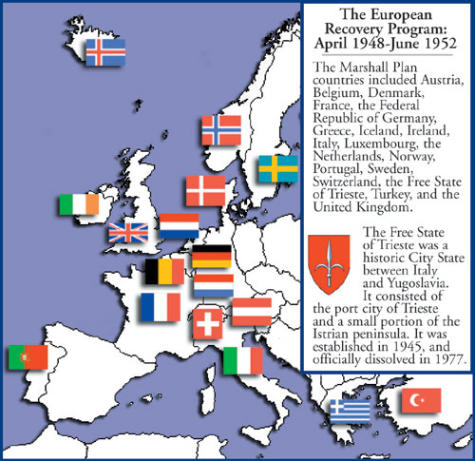
The Marshall Plan
European Recovery Plan
16 countries received aid.
1947
$13 Billion in aid given to rebuild Western Europe.
Offered to Eastern Europe but Soviet Union said NO!

Slide 7
Form
Economic

Slide 8
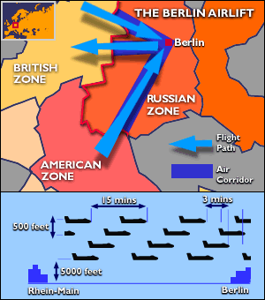
Berlin Airlift
Stalin cut off supplies into W. Berlin
US airlift food and supplies into the city
1948
Lasted 11 months
Stalin reopened supply lines

Slide 9
Form
Economic

Slide 10
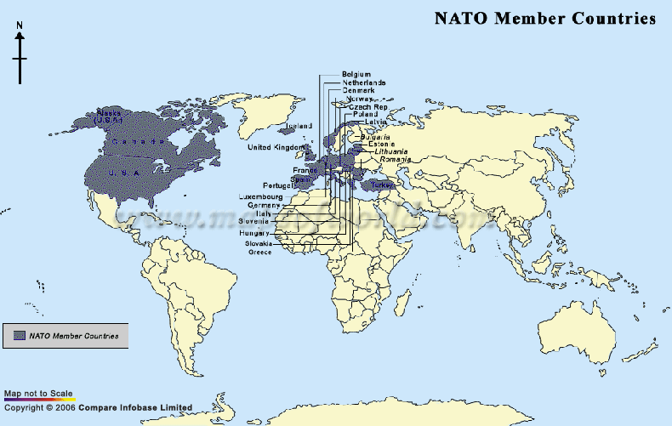
NATO
North Atlantic Treaty Organization
1949
Collective Security
Alliance to support one another militarily
Had to be a democracy

Slide 11
Form
Political
Military

Slide 12
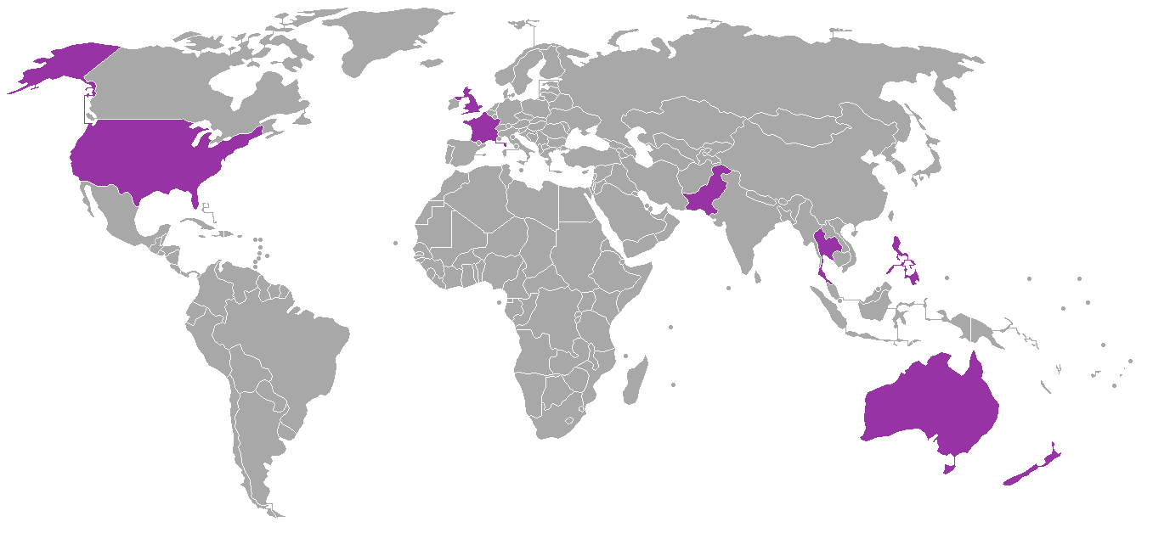
SEATO
South East Asian Treaty Organization
1954
US + 7 other nations
To prevent the Domino Theory

Slide 13
Form
Political
Military

Slide 14
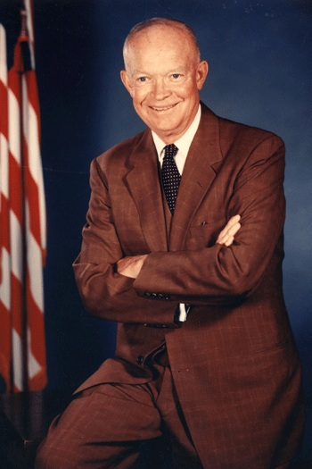
Eisenhower Doctrine
Like the Truman Doctrine but for the Middle East
1957
Offered economic & military support if communism threatened the Middle East

Slide 15
Form
Economic

Slide 16
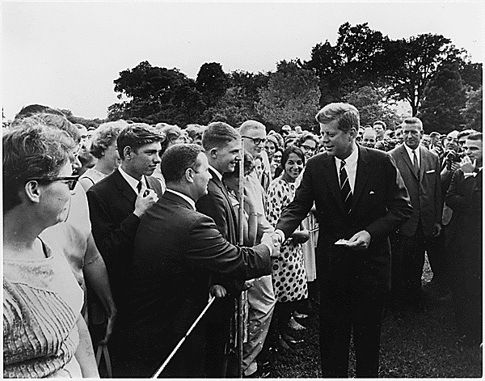
Peace Corps.
Program of volunteer assistance to developing nations of Asia, Africa, & Latin America.
1961
By 1968, 35,000 volunteers had helped in 60 nations

Slide 17
Form
Economic

Slide 18
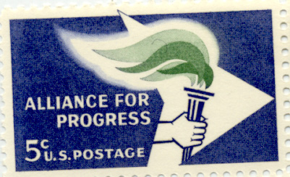
Alliance for Progress
Foreign Aid Program
1961
Offered economic & technical assistance to Latin American countries.
US invested $12 billion

Slide 19
Form
Economic

