Slide 1
The Cold War
Outcome: Presidential Timeline
*Denotes Containment Program; S.U. = Soviet Union

Slide 2
Harry Truman (D)

Slide 3
Harry Truman (D)
1945 – WWII ends with Truman’s decision to drop A-bomb on Japan
1954 – The United Nations is created
1946 – W. Churchill claimed an Iron Curtain has descended upon Europe
1947 – *Truman Doctrine aid is aimed at saving Greece & Turkey
1948 – U.S.S.R. cuts off supply route to W. Berlin and U.S. responds with an airlift
1948 – *Marshall Plan aid will rebuild Western Europe
1949 – U.S.S.R. detonates their first A-bomb

Slide 4
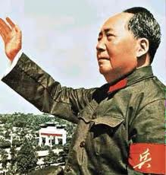
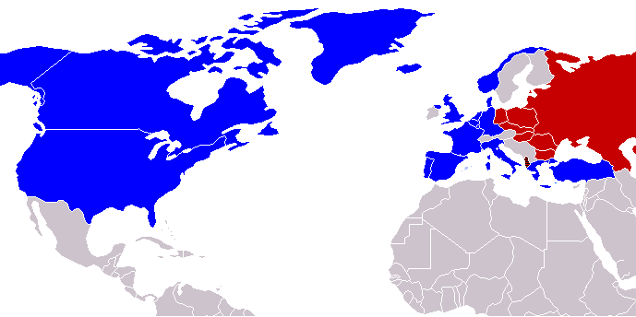
Harry Truman (D)
1949 – Civil War in China turns most populous country into a Communist Nation
1949 – *N.A.T.O. Alliance is created to offset Soviet influence in E. Europe

Slide 5
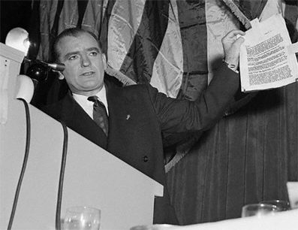
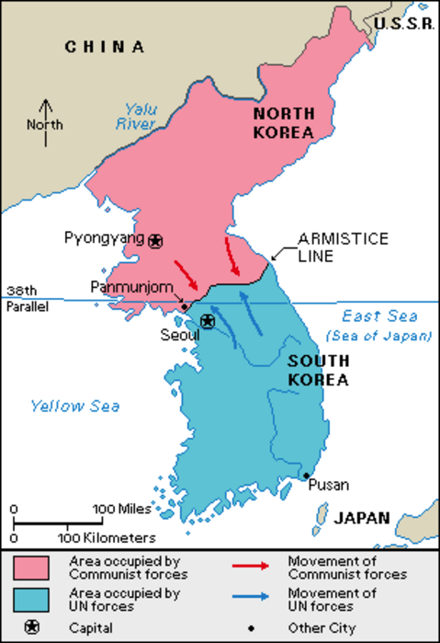
Harry Truman (D)
1950 – *Korean Conflict begins; as a result United Nations police action begins to defend S. Korea
1950 – (R) Sen. J. McCarthy claims communists have infested the government, starts 2nd Red Scare

Slide 6
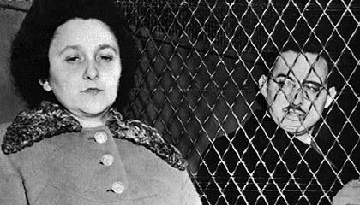
Julius & Ethel Rosenberg
1951 – Rosenbergs are tried and sentenced for providing nuclear secrets to the Soviets; executed 1953

Slide 7
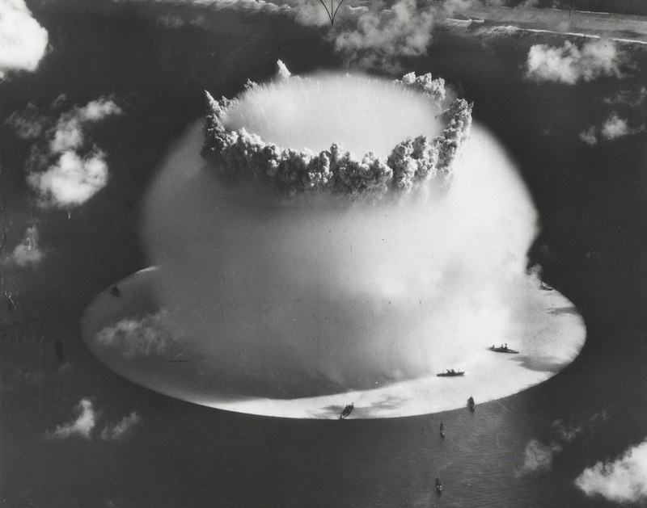
The Hydrogen Bomb
1952 – The first H-Bomb is detonated by U.S.

Slide 8
Dwight D. Eisenhower (R)

Slide 9
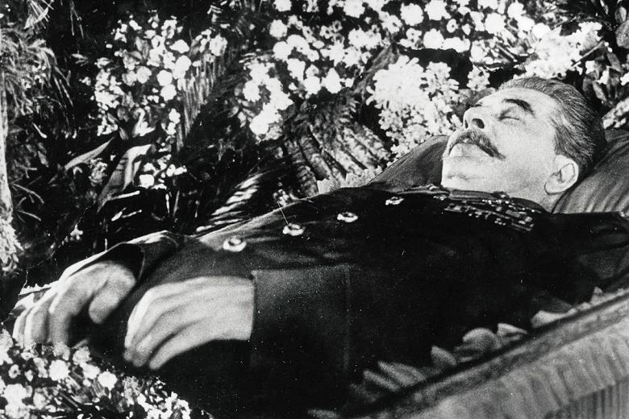
Dwight D. Eisenhower (R)
1953 – Stalin Dies

Slide 10
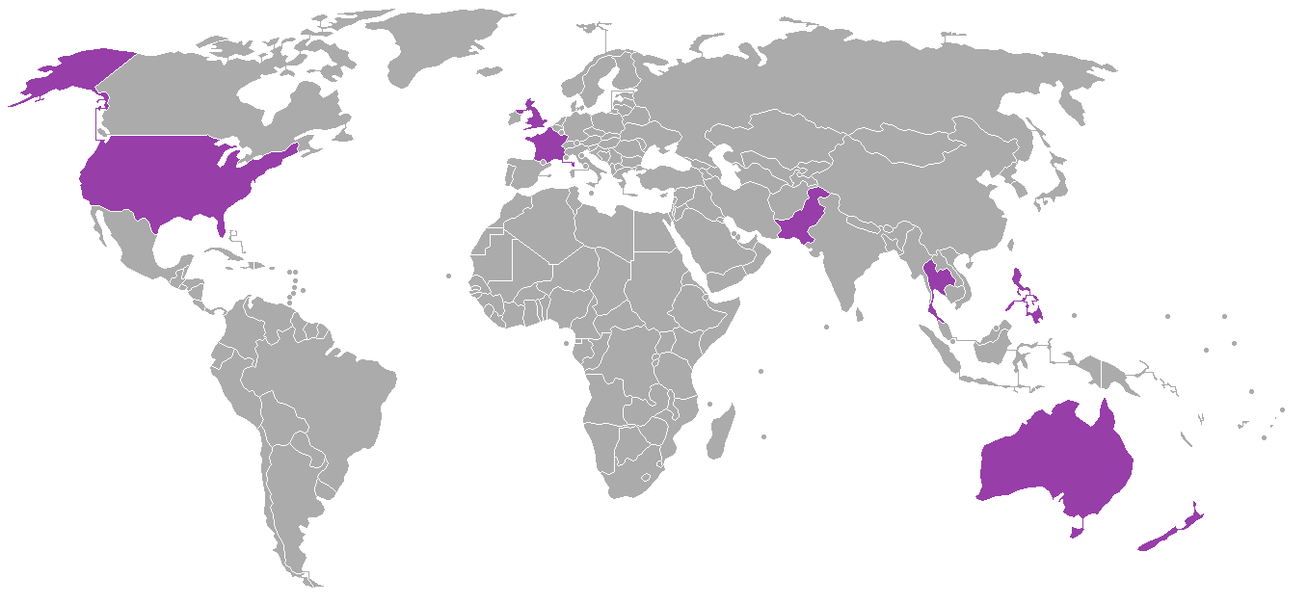
Dwight D. Eisenhower (R)
1953 – Korean Conflict ends in a stalemate at the 38th parallel
1954 – *S.E.A.T.O. Alliance forms to pr0tect S.E. Asia

Slide 11
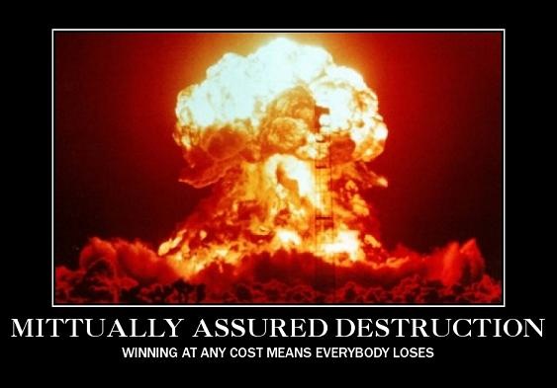
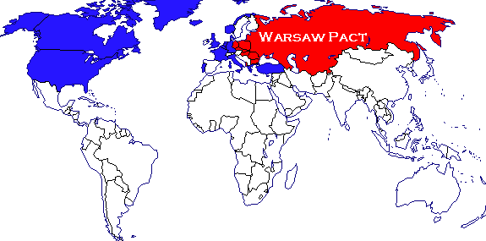
Dwight D. Eisenhower (R)
1955 – Mutually Assured Destruction or MAD Plan introduced by John Foster Dulles
1955 – S.U. creates Warsaw Pact to offset NATO

Slide 12
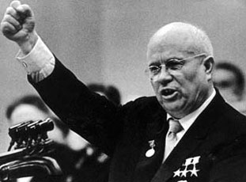
Dwight D. Eisenhower (R)
1956 – New Soviet Premier Nikita Khrushchev proposes idea of “peaceful coexistence”

Slide 13
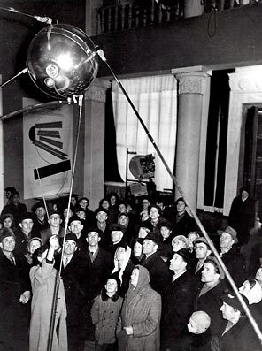
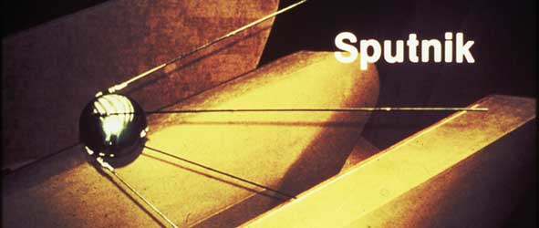
Dwight D. Eisenhower (R)
1957 – Sputnik launches the U.S. & Soviets into a space race

Slide 14
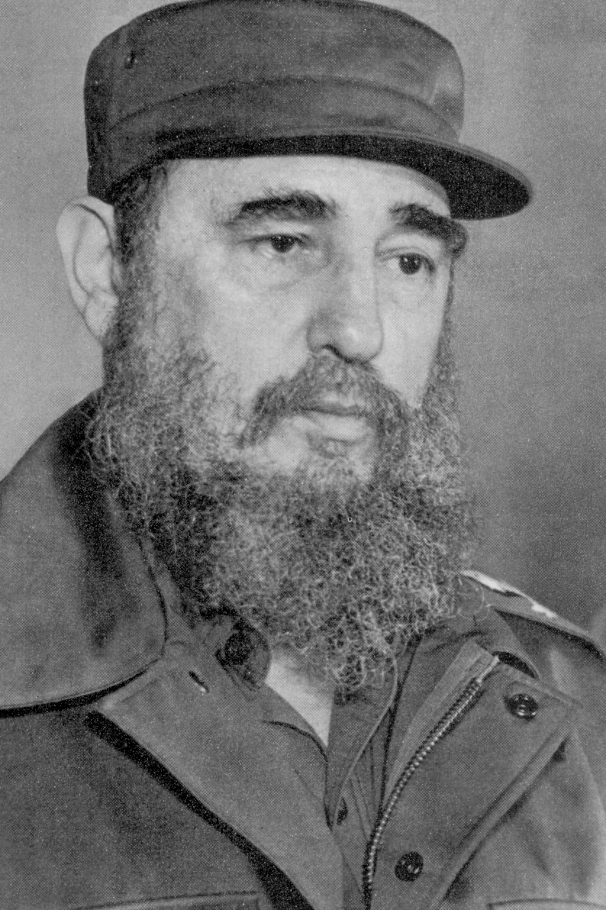
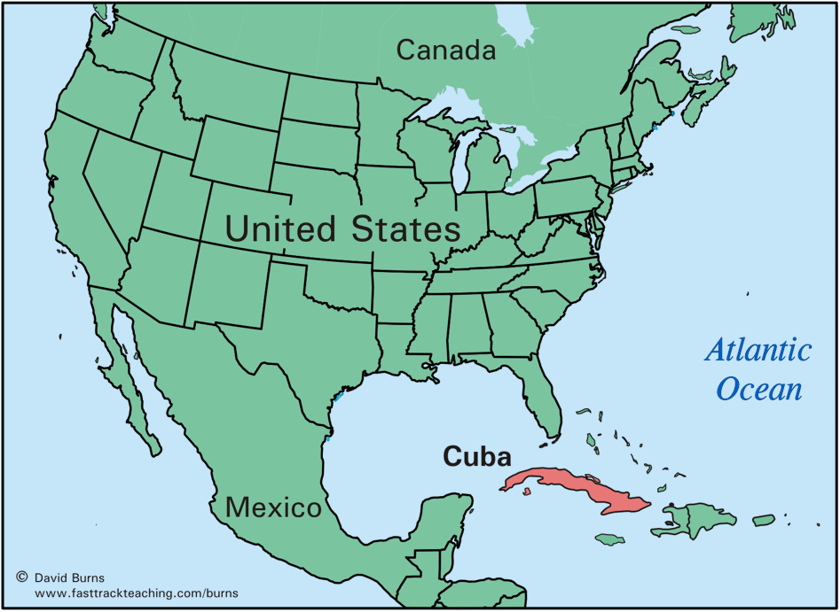
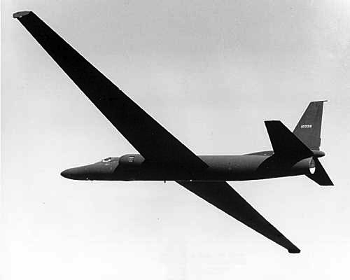
Dwight D. Eisenhower (R)
1957 – *Eisenhower Doctrine is offered to Middle East countries
1959 – Communist dictator Fidel Castro (Cuba), takes power and seizes all US assets and priv. property
1960 – Francis Gary Powers is shot down in his U-2 spy plane over U.S.S.R.

Slide 15
John F. Kennedy (D)

Slide 16
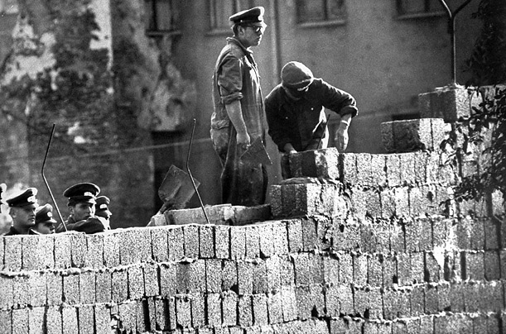
John F. Kennedy (D)
1961 – Soviets begin constructing Berlin Wall

Slide 17
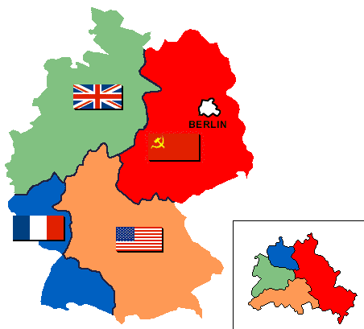
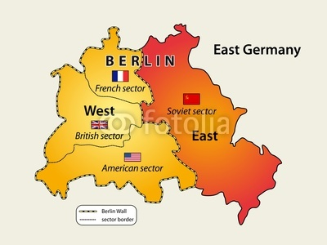
East & West Germany with
East and West Berlin
Berlin Wall

Slide 18
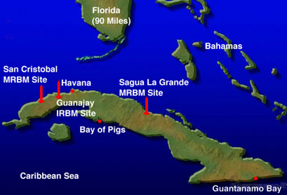
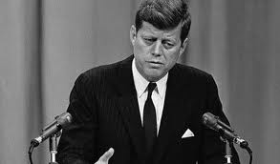
John F. Kennedy (D)
1961 – Bay of Pigs invasion by 1500 CIA-trained Cuban exiles in attempt to overthrow Castro (Failure)

Slide 19
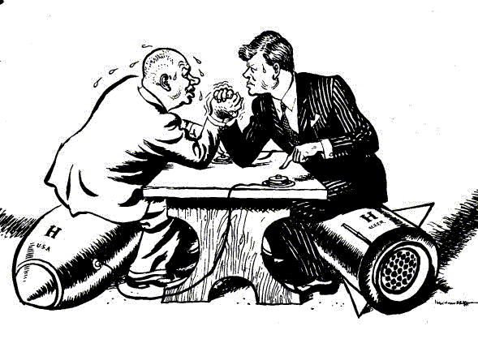
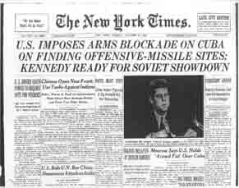
John F. Kennedy (D)
1962 – U.S. President JFK and Soviet Premiere Khrushchev involve world in the Cuban Missile Crisis

Slide 20
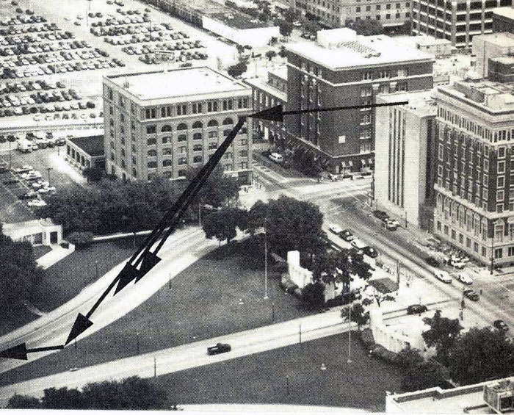
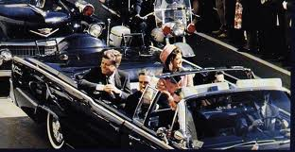
John F. Kennedy (D)
1963 – JFK is shot and killed in Dallas, TX

Slide 21
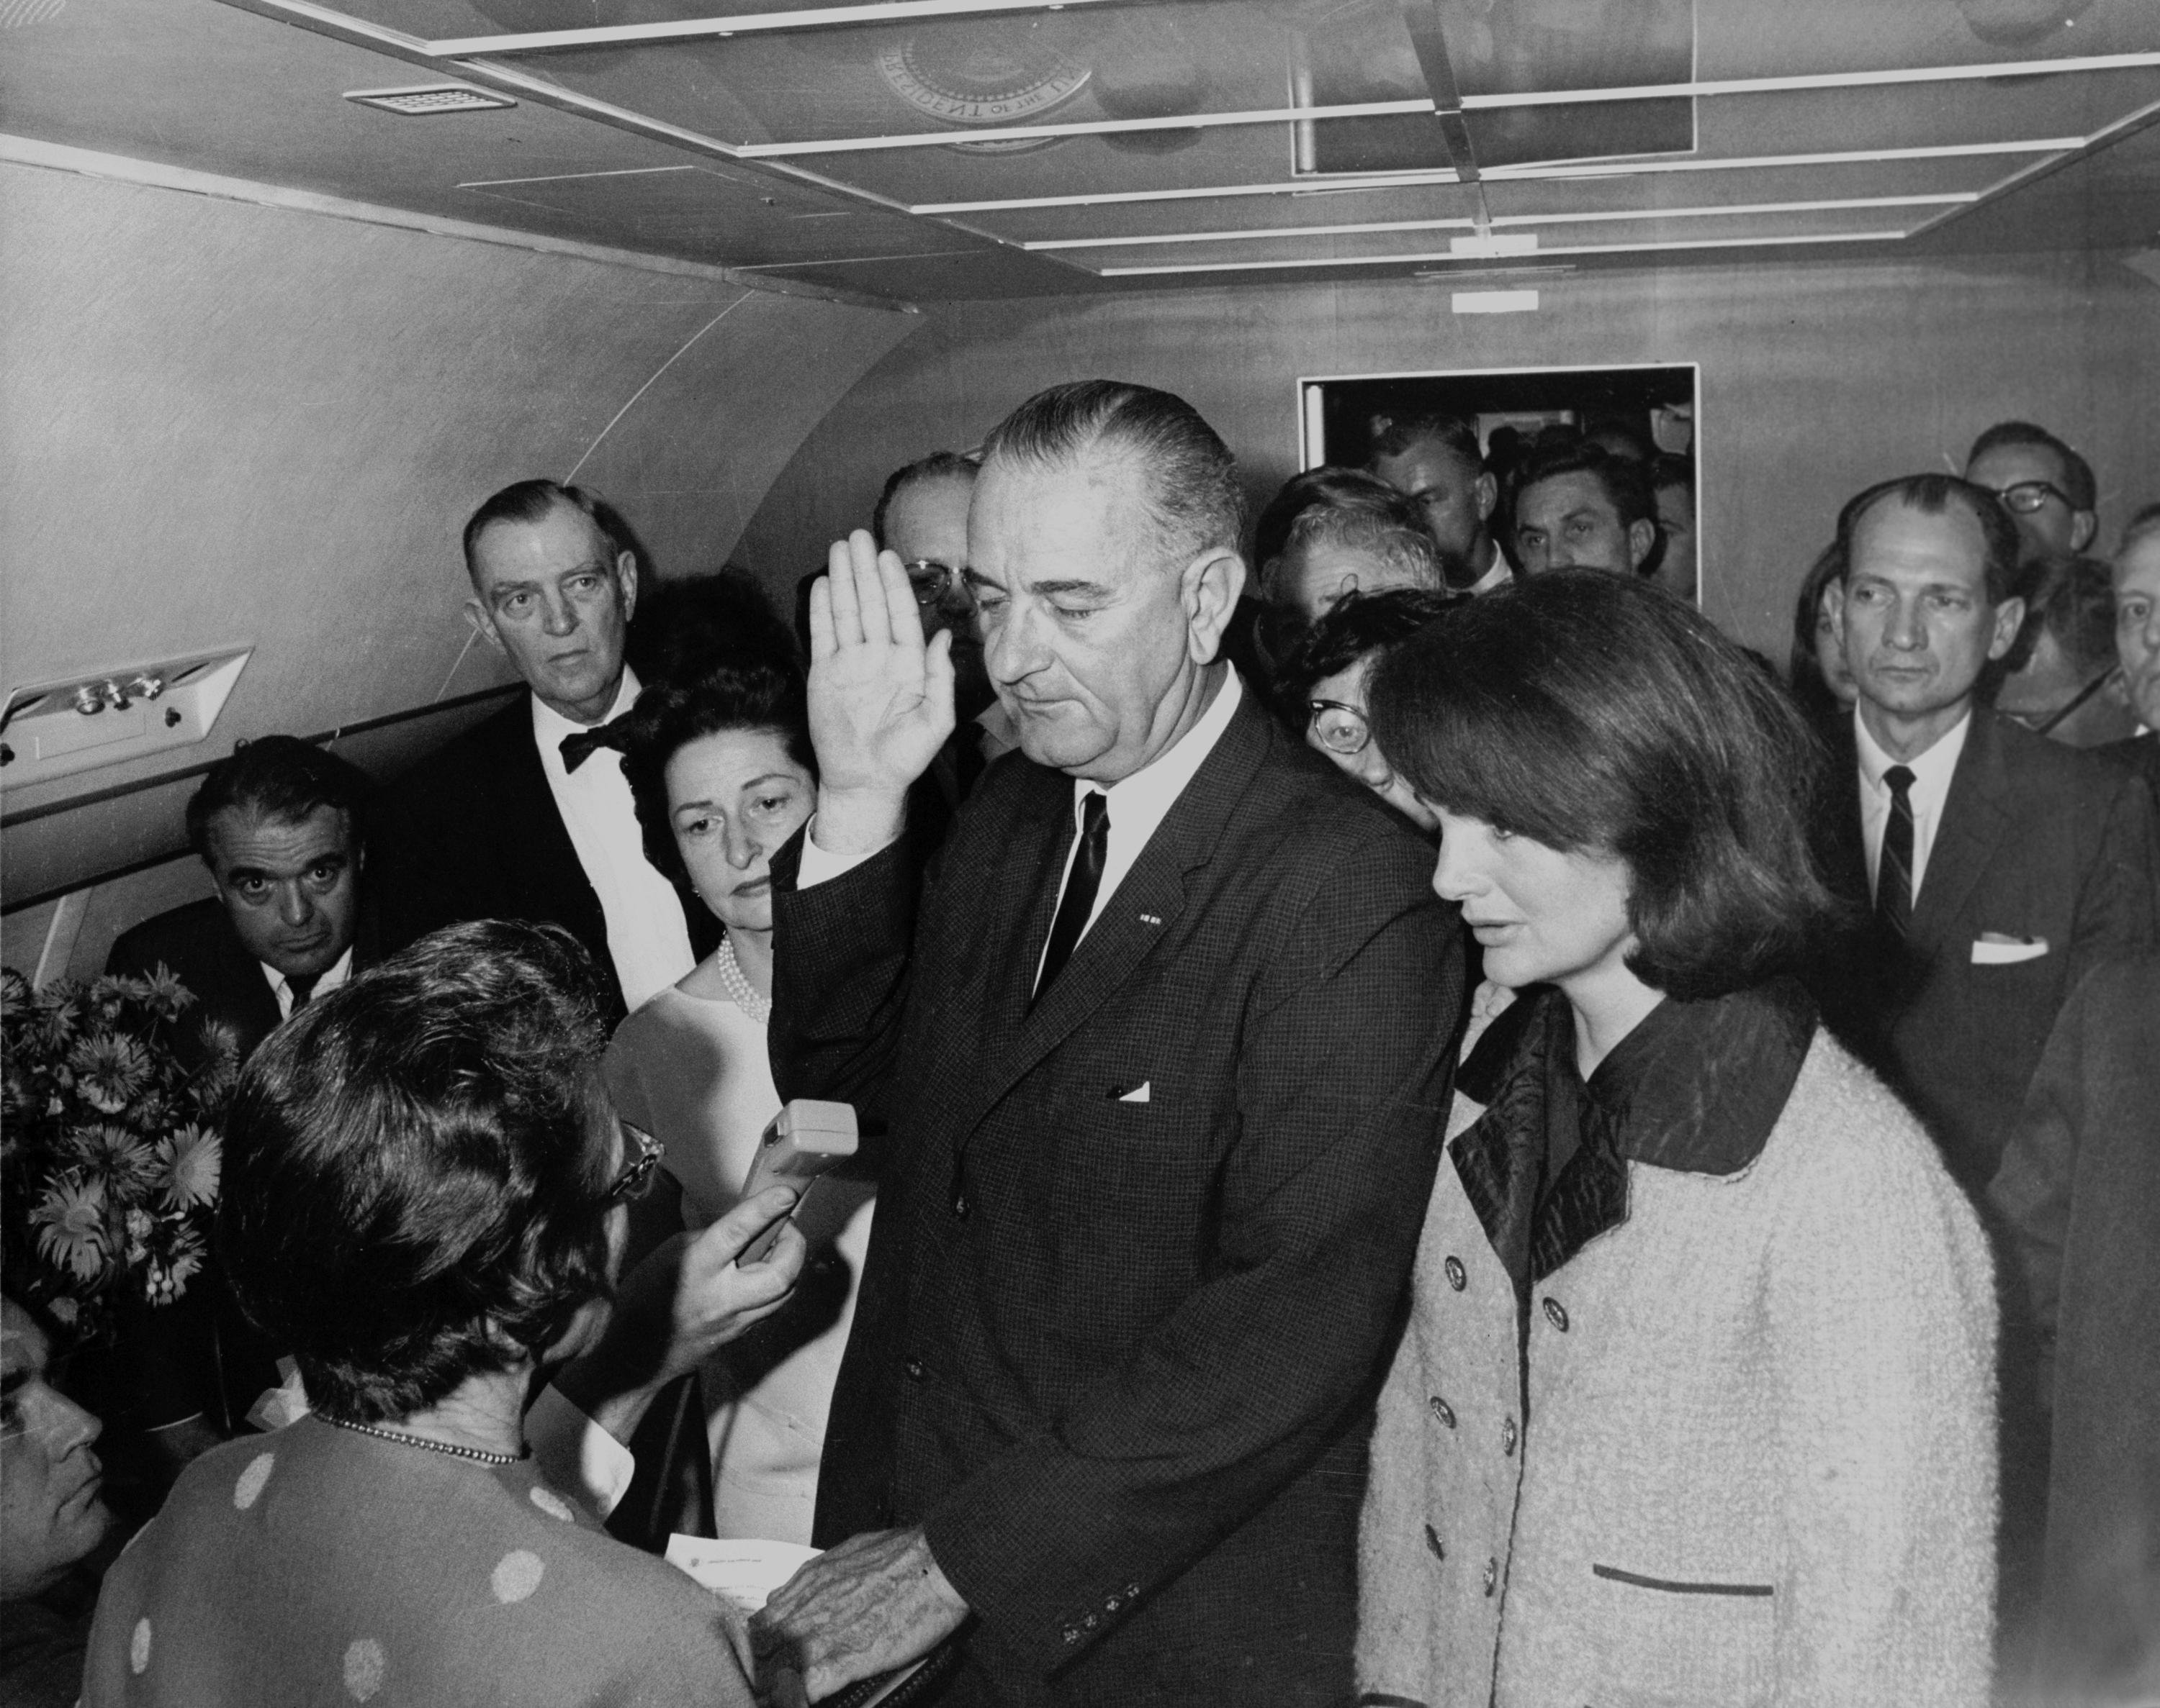
Johnson sworn in on Air Force One

Slide 22
Lyndon B. Johnson (D)

Slide 23
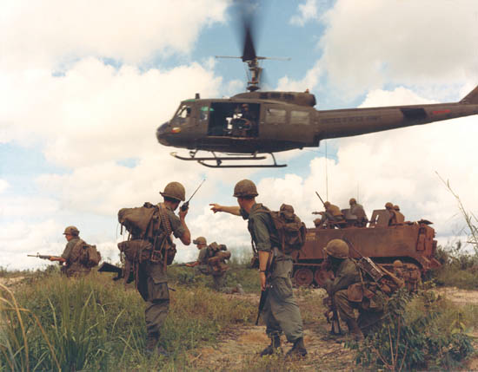
Lyndon B. Johnson (D)
1964 – U.S. passes resolution to increase troops in S. Vietnam
1968 – U.S. involvement in Vietnam peaks; popular opinion drops
More on this later

Slide 24
Richard Nixon (R)

Slide 25
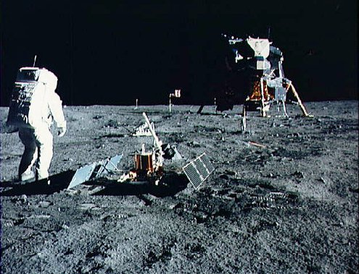
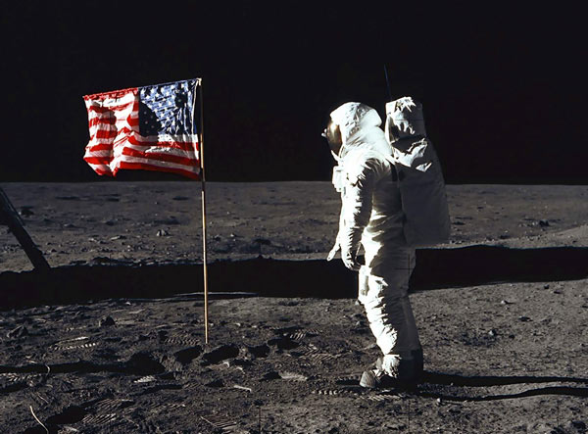
Richard Nixon (R)
1969 – NASA achieves moon landing

Slide 26
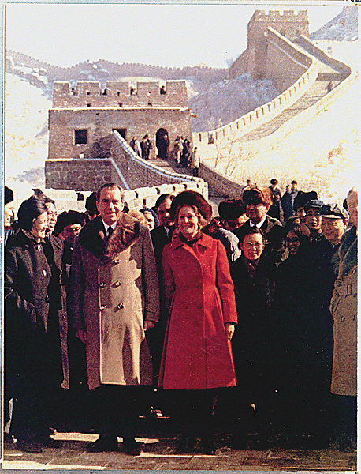
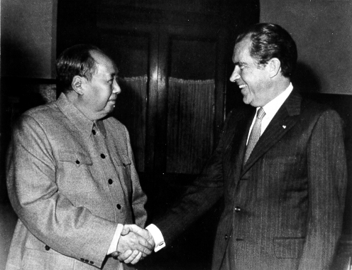
Richard Nixon (R)
1972 – Nixon recognizes China & visits the Soviet Union

Slide 27
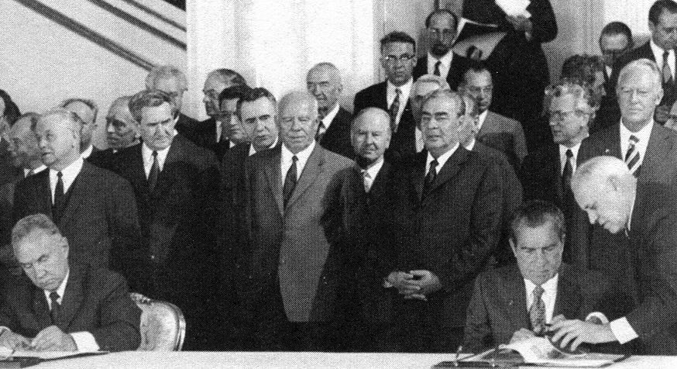
Richard Nixon (R)
1972 – First Strategic Arms Limitation Treaty (SALT)
1973 – U.S. pulls out of Vietnam; 1975 dominos fall

Slide 28
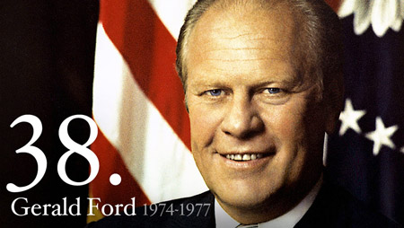
Gerald Ford (R)

Slide 29
Jimmy Carter (D)

Slide 30
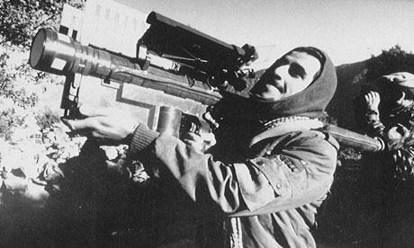
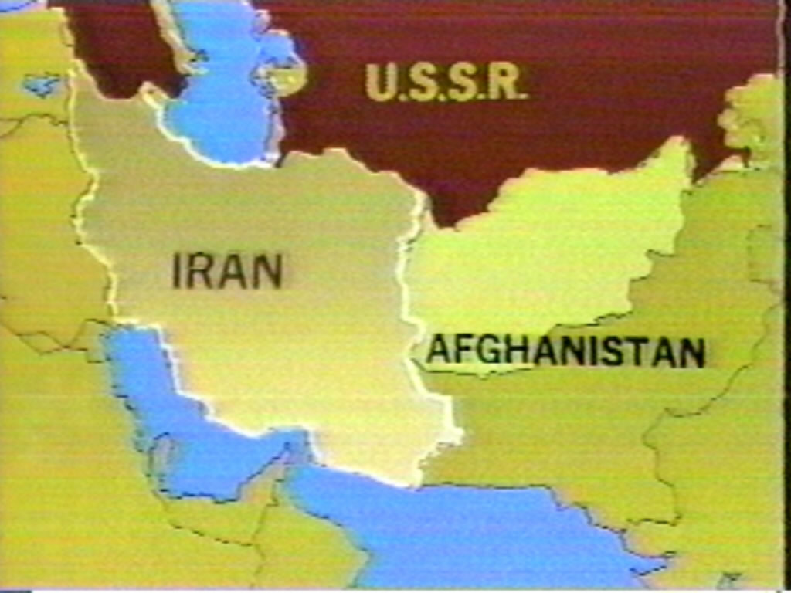
Jimmy Carter (D)
1979 – Soviets invade Afghanistan
1980 – U.S. supports freedom fighters

Slide 31
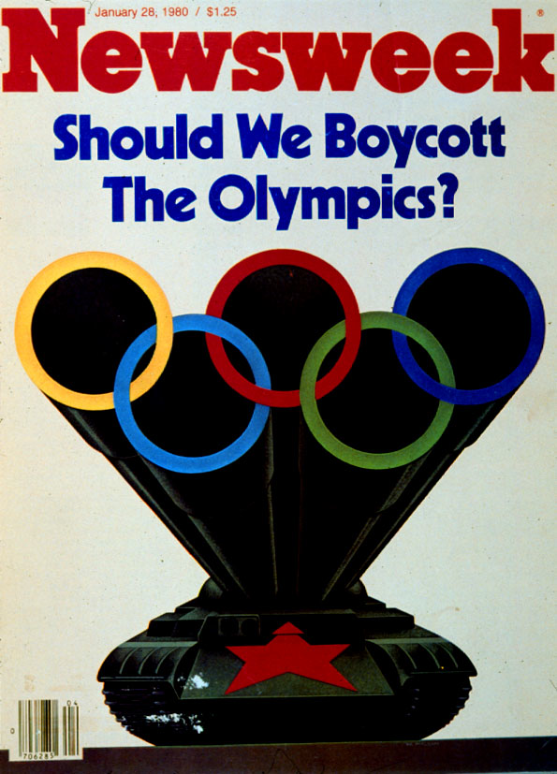
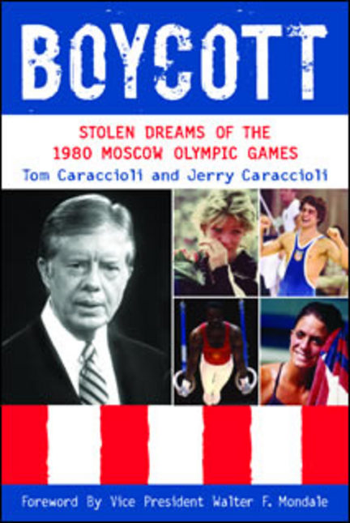
Jimmy Carter (D)
1980 – U.S. boycotts Moscow Summer Olympics in protest

Slide 32
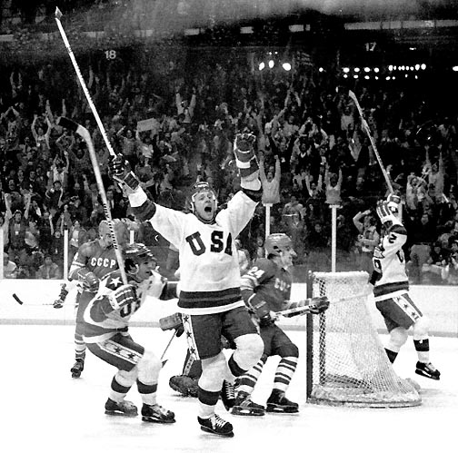
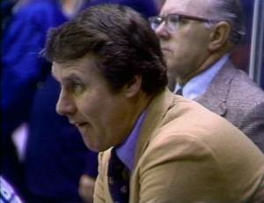
Jimmy Carter (D)
1980 – “Miracle on Ice” occurs during Winter Olympics

Slide 33
Miracle on Ice

Slide 34
Ronald Reagan (R)

Slide 35
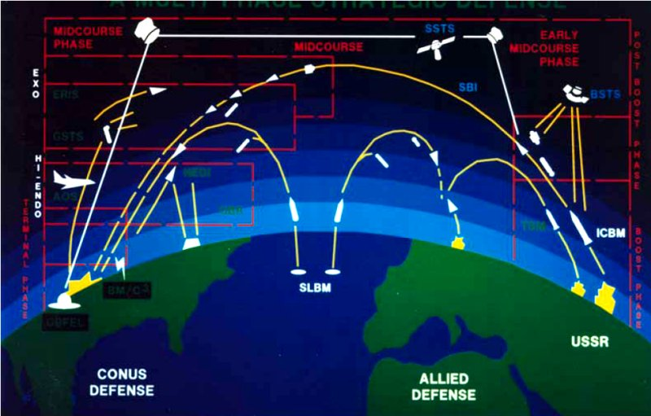
Ronald Reagan (R)
1983 – Strategic Defense Initiative or Star Wars initiated by President Reagan

Slide 36
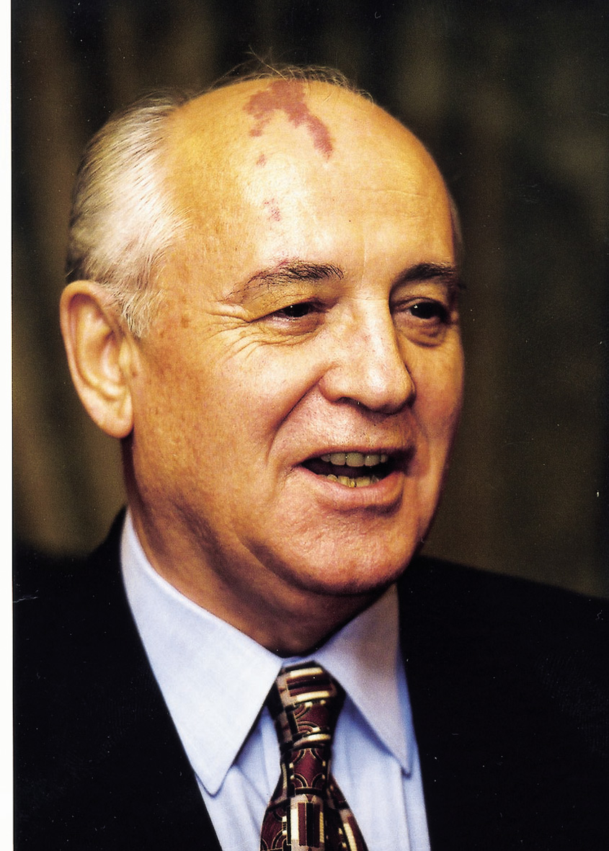
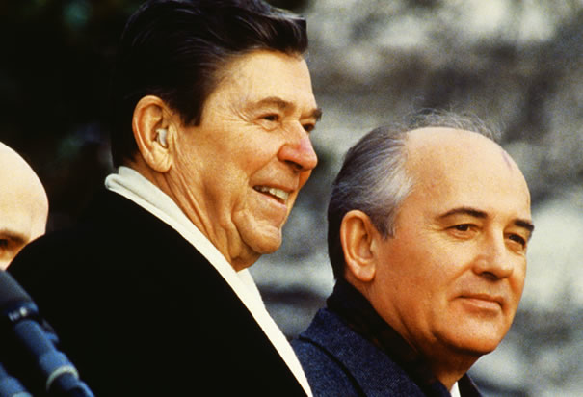
Ronald Reagan (R)
1985 – Gorbachev comes to power and introduces democratic (Glasnost) and Capitalism (Perestroika) reforms

Slide 37
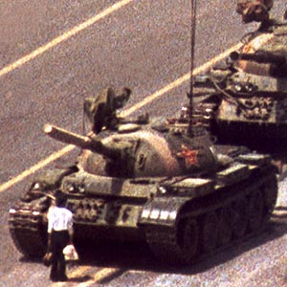
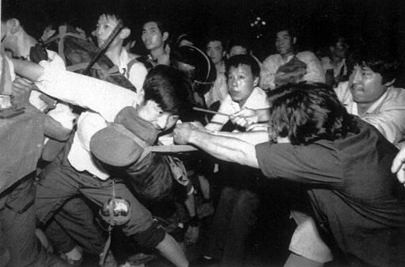
Ronald Reagan (R)
1989 – Tiananmen Square Massacre in China

Slide 38
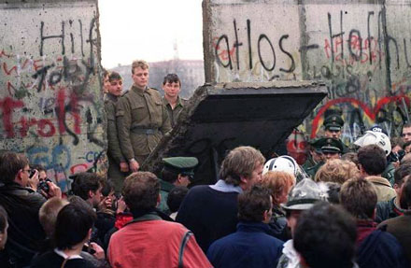
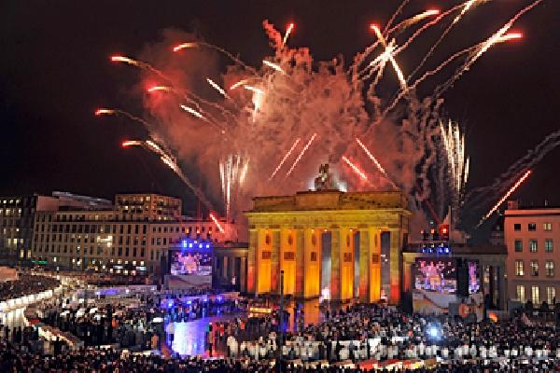
Ronald Reagan (R)
1988 – Soviets leave Afghanistan (beaten & frustrated)
1989 – Berlin Wall falls; S.U. loses its satellite nations

Slide 39
George Bush Sr. (R)

Slide 40
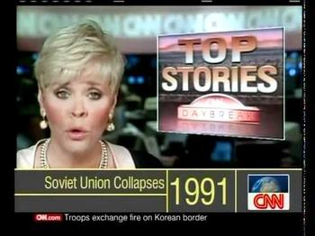
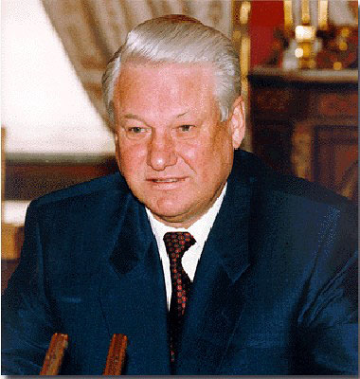
George Bush Sr. (R)
1991 – Soviet Union collapses
1991 – Russia elects Boris Yeltsin to lead new democracy

Slide 41
We Win!
No more Soviet Union means no more Cold War.
Capitalism wins and Communism loses!

