Slide 1
The Last 35 Years
Outcomes: Bill Clinton, George W. Bush, & Barrack Obama

Slide 2
The Persian Gulf War

Slide 3
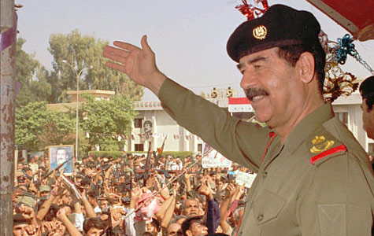
The Persian Gulf War

Slide 4
Bill Clinton, George W. Bush, & Barrack Obama
Setting the Stage: Persian Gulf War
Saddam Hussein claimed Kuwait belonged to Iraq
Iraq invaded Kuwait on Aug 2, 1990
President Bush launched Operation Desert Storm to liberate Kuwait
Cease-fire announced on Feb 28, 1991. Kuwait was liberated.
Saddam Hussein was still in control of Iraq

Slide 5
Bill Clinton
1992 Election
A recession forced Bush to raise taxes; approval rating dropped to 49% in 1992
12 years of Republican leadership came to an end
Bill Clinton (D) from Arkansas defeated Bush and Texas billionaire Ross Perot

Slide 6
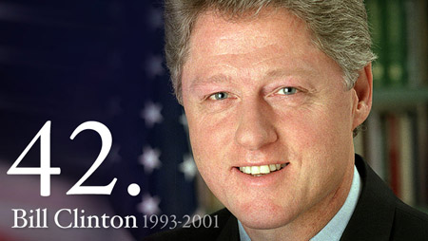
Bill Clinton

Slide 7
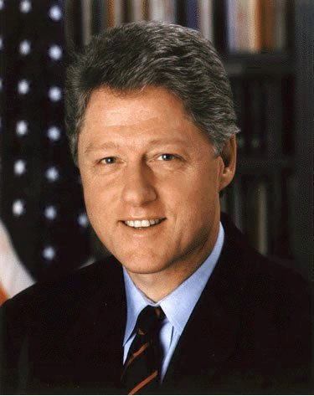
Bill Clinton
Clinton Pros
Economy extremely strong; balanced the budget
1998 announced the federal government had a surplus, first time in nearly 30 years
Unemployment fell, stock market soared, fewer people relied on public aid
Improved relations with former Cold War enemies Russia and China
NAFTA was created to strengthen economies of Canada, US, and Mexico

Slide 8
Bill Clinton
Clinton Cons
Whitewater scandal lead to Clinton being impeached
Lied about having sexual relations with White House intern Monica Lewinsky
Senate fell short of two-thirds majority to convict Clinton
Some criticized Clinton for not intervening more in Rwanda

Slide 9
George W. Bush
2000 Election
Clinton’s VP Al Gore (D) won the popular vote over George W. Bush (R)
Recount in key state FL showed that Bush won more electoral votes & election
Bush’s brother was governor of FL; recounts were ended in Dec by Sup. Ct.

Slide 10
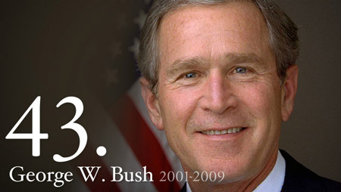
George W. Bush

Slide 11
September 11, 2001

Slide 12
George W. Bush
September 11, 2001
Islamic Fundamentalist Terrorists from Al-Qaeda flew planes into the World Trade Center in NYC, The Pentagon in Wash DC, and outside of Philadelphia
Osama Bin Laden planned the attacks; roughly 3,000 were killed
Bush administration increased antiterrorism measures

Slide 13
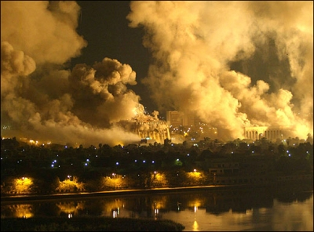
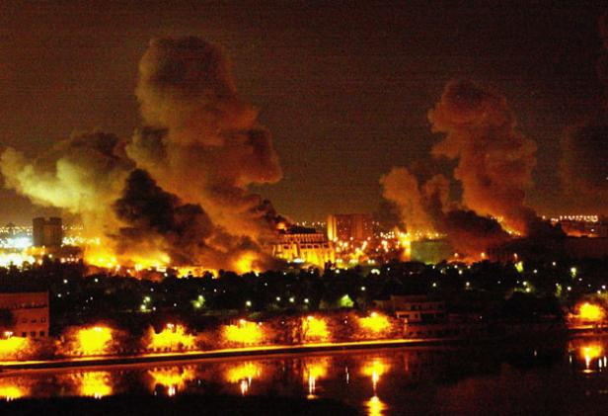
George W. Bush
Invasion of Iraq
US and British forces invaded Iraq in March of 2003
Feared Saddam had weapons of mass destruction (WMD), none were found
Motivation changed to “Liberate Iraq;” Saddam was found, tried, and executed ‘06

Slide 14
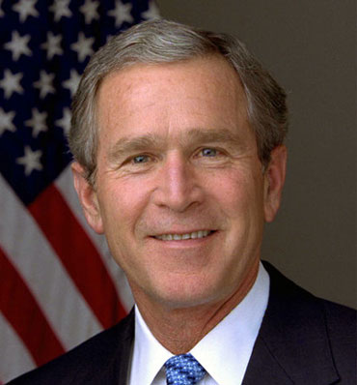
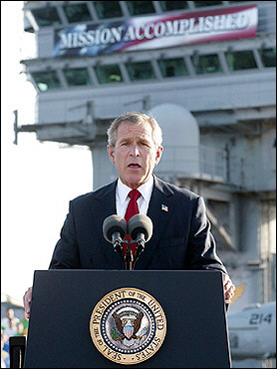
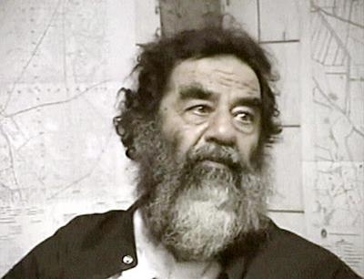
George W. Bush
George W. Bush’s Legacy
Bad timing: 9-11-01
Was the invasion of Iraq necessary? Possible oil connection?
Positive: Helped rid Iraq of Saddam Hussein
Recession following his presidency

Slide 15
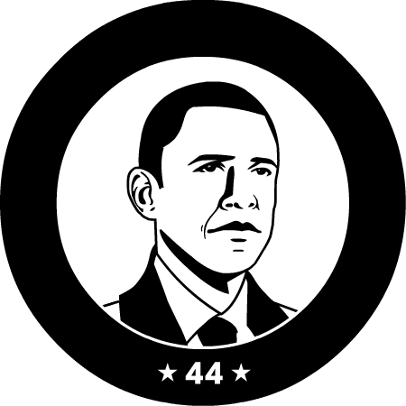
Barack Obama
2008 Election
Bush’s VP Dick Cheney did not run for office
Democrat Barack Obama vs. Republican John McCain
Obama won becoming first black president in US history

Slide 16
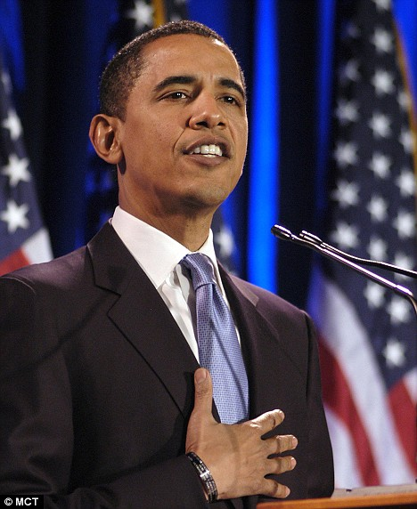
Barack Obama
Barack Obama’s Presidency
Inherited the most costly war in US history
Inherited a rough economy
Attempting to fix health care in US; very difficult task
Approved mission that found and killed Osama bin Laden
Ongoing debt crisis
Legacy? To be determined…

