Slide 1
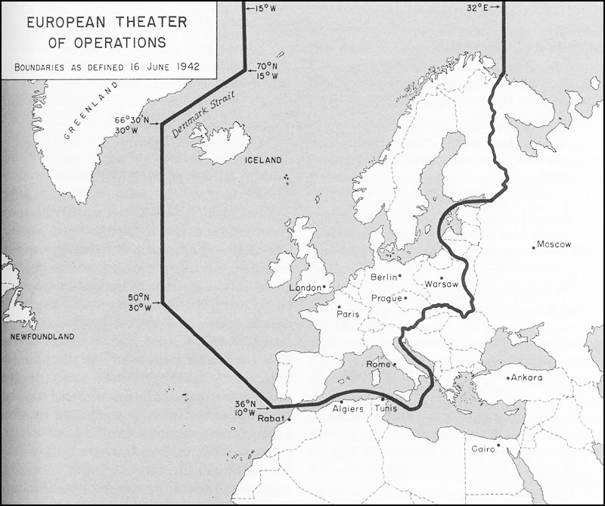
World War II
Outcome: The European Theater

Slide 2
The European Theater
Aggression in Europe
Italy invaded Ethiopia and took control in 1935
Spain’s Civil War was won by the fascists in 1936
Germany
1936: Hitler had rearmed and sent troops to the Rhineland
1938: Hitler annexed Austria & demanded the Sudetenland (W. Czech)

Slide 3
The European Theater
1938: Munich Conference (Germany, Italy, Britain, & France)
Goal: To stop further German aggression in Europe
Result: The Munich Pact gave Hitler the Sudetenland if he promised to end territorial demands
Policy: “Appeasement”
March 1939: Germany took rest of Czechoslovakia (appeasement failed)
France & Britain pledged war if aggression continued
1939: Hitler & Stalin signed a “Non-Aggression Pact”

Slide 4
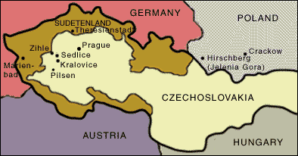
The Sudetenland

Slide 5
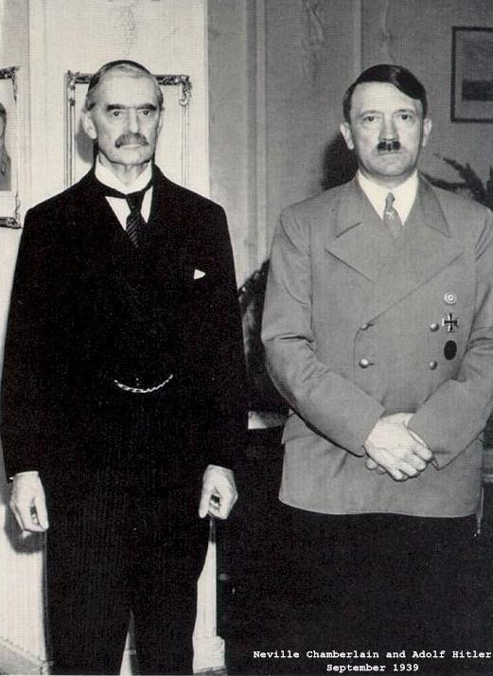
Neville Chamberlain

Slide 6
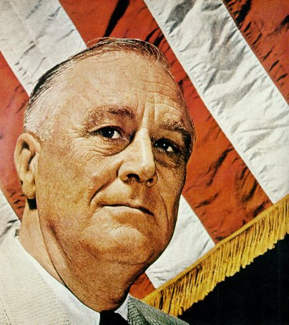
The European Theater
United States’ reaction to foreign aggression
1935: passed Neutrality Act – no arms to warring nations
1939: “Cash-n-Carry” policy (purpose to aid the Allies)

Slide 7
The European Theater
War in Europe (Early Period)
Sept. 1, 1939: Germany invaded Poland with blitzkrieg attack (WWII begins)
France & Great Britain declare war the next day
The Holocaust intensifies

Slide 8
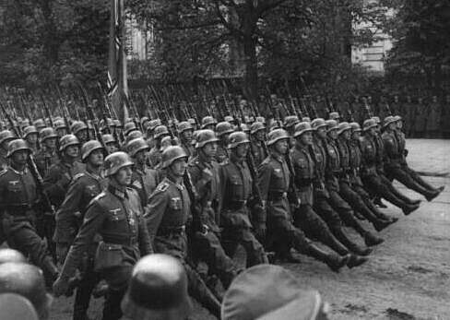
The European Theater
“Phony War” Period (“Sitzkrieg”) ---> Sept 1939-April 1940
April, 1940: Germany resumed “Blitzkrieg” attacks
Neutral nations fell quickly ---> Denmark, Netherlands, Belgium, Norway
France fell to Hitler in late June 1940

Slide 9
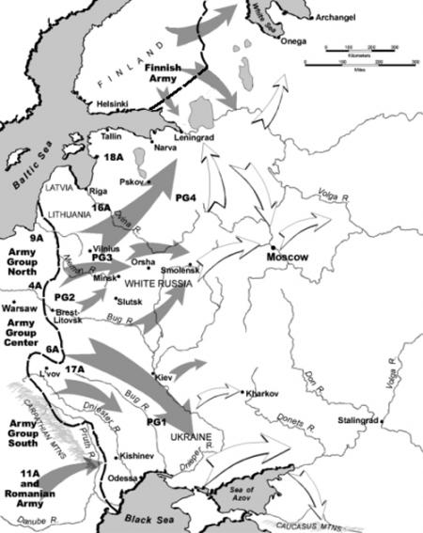
The European Theater
Summer/Fall, 1940: Battle of Britain (German Luftwaffe vs. Royal Air Force RAF)
June, 1941: Hitler double crossed Stalin and invaded Russia through Poland
Big Mistake! Stalin used Scorched Earth military tactic
Harsh winter and lack of useable supplies resulted in over 1 million Nazi loses

Slide 10
The European Theater
Diplomacy was Failing
Appeasement was ineffective when dealing with Hitler
Sept 1940: Germany, Italy, and Japan signed the Tripartite Pact (Axis Powers)
U.S. Neutrality? Biased?
1940: WWI destroyers given for bases deal with Great Britain
1941: Lend-Lease Act --> U.S. became the “Arsenal of Democracy”
1941: FDR and W. Churchill (Britain) agreed to the Atlantic Charter

Slide 11
The European Theater
Last Events to U.S. Entry
1941: U.S. attempted to stop Japan’s invasion of China (in Civil War)
Sent ultimatum (warning)
Issued a scrap metal and oil embargo

Slide 12
The European Theater
By Aug. 1941: Indo-China fell to Japan
U.S. began a full trade embargo against Japan
Japan responded by:
Sending a negotiator to Washington D.C.
Preparing for an attack on the U.S. (decoded message)

Slide 13
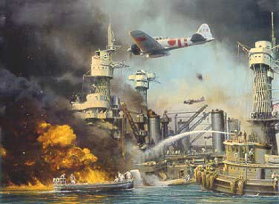
Japanese Attack Pearl Harbor

Slide 14
The European Theater
December 7th, 1941: Japanese Attack on Pearl Harbor
U.S. Pacific Fleet was based at Pearl Harbor in Hawaii
Attack was meant to cripple U.S. fleet so couldn’t interfere with Japan
Six aircraft carriers and 353 Japanese planes attacked in two waves
2,403 died (1,177 killed on the U.S.S. Arizona)
U.S. declared war on Japan the next day “…Date that will live in Infamy…”
Germany & Italy declared war on the U.S. on Dec 8, 1941 (Tripartite Pact)
The U.S. was officially in the war! (Isolationism was over)

Slide 15
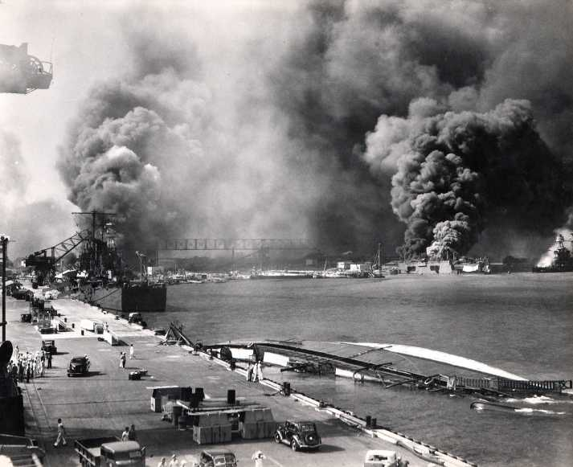

Slide 16
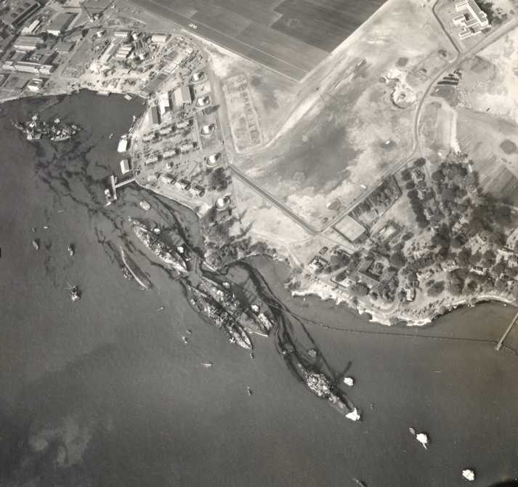

Slide 17
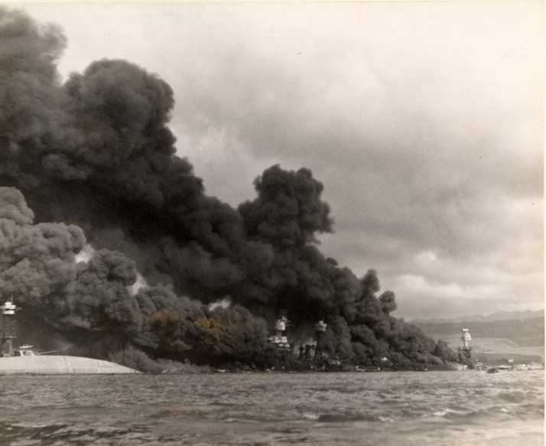

Slide 18
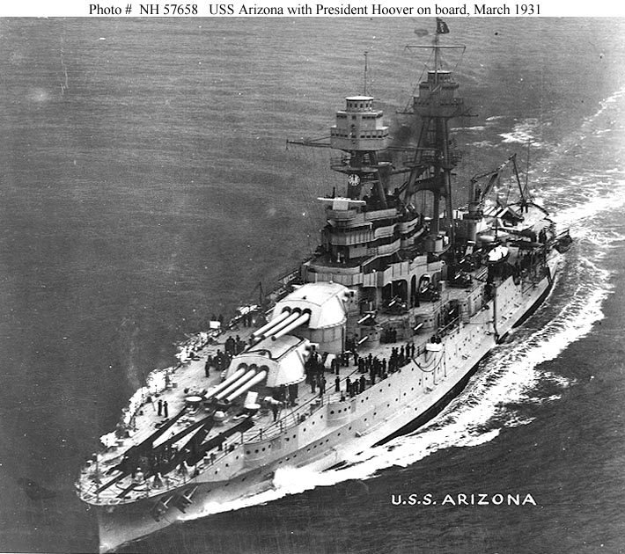
U.S.S. Arizona

Slide 20
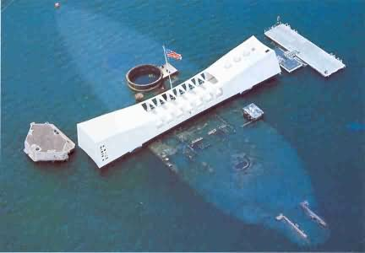
U.S.S. Arizona Today

Slide 21
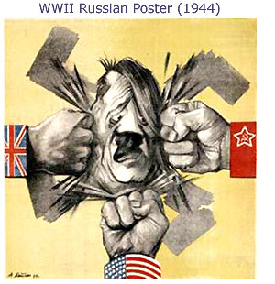
The European Theater
Key Nations at War
Allies: Great Britain, France, Soviet Union, United States
Axis: Germany, Italy, Japan

Slide 22
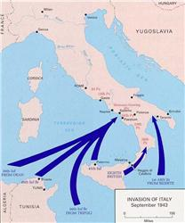
The European Theater
European Theater
Name given to the fighting that took place in Europe
1942: Britain stood alone against Axis
Gen. Dwight Eisenhower = Supreme Allied Commander of the European Theater
Allies first invaded through Sicily and up into Italy
Mussolini was overthrown and killed

Slide 23
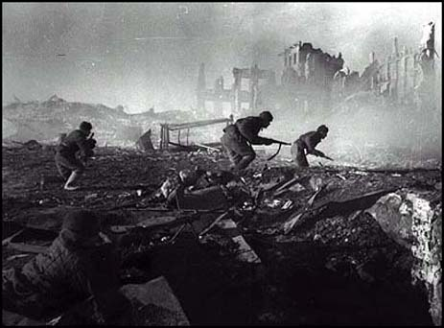
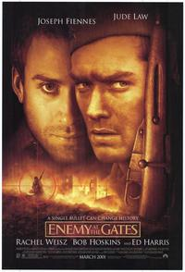
The European Theater
Eastern Front: Stalingrad
The Nazis were fighting the Russians in Stalingrad (Aug 1942-Feb 1943)
One of the bloodiest battles in the history of warfare
Nazis are defeated; turning point of the war for the Allies

Slide 24
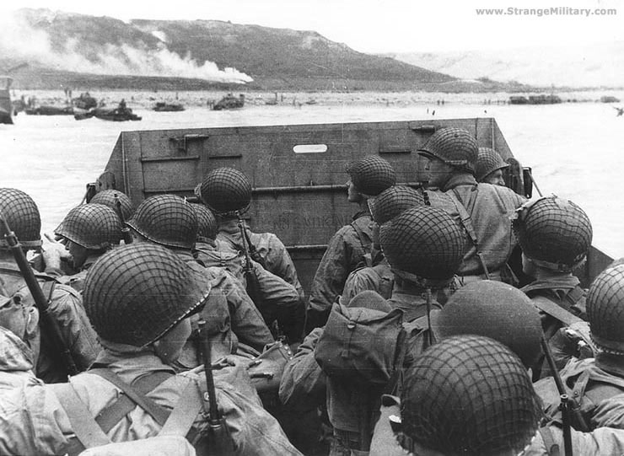
D-Day

Slide 25
The European Theater
Western Front: D-Day
General Eisenhower planned D-Day for June 6, 1944
Allied invasion across English Channel into Normandy, France
Largest military invasion in history
Allies success allowed them to push further into France

Slide 26
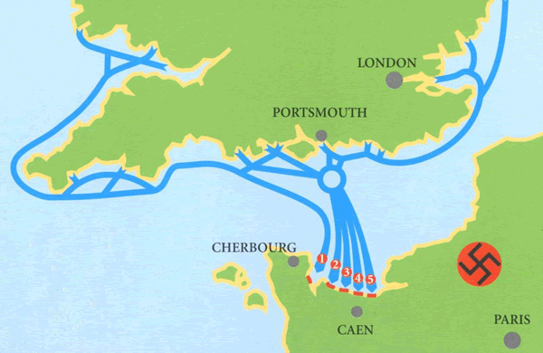
D-Day Map

Slide 27
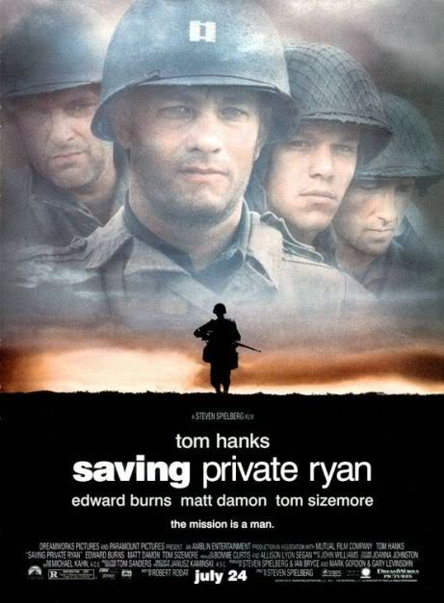

Slide 28
The European Theater
Battle of the Bulge
Hitler’s last major offensive
Allies were pushing from the West (from France), South through Italy, and from the East (Soviets)
Germany was surrounded

Slide 29
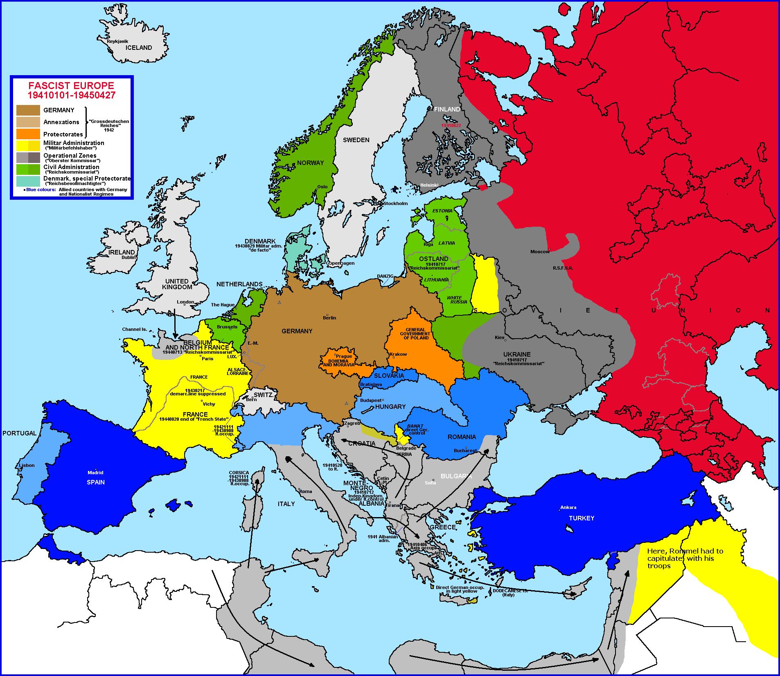

Slide 30
The European Theater
German Surrender
Hitler committed suicide before he could be captured
Germany officially surrendered on May 7, 1945; following day is known as VE Day
Now the Allies had to figure out how to defeat Japan

